Slide 1
NWAV 44
Welcomes our publishers

Slide 2
Our venue
Hart House on campus at the University of Toronto

Slide 3
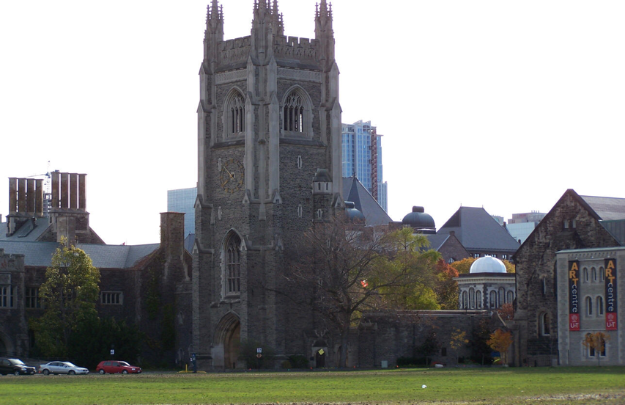
A neo-gothic treasure

Slide 4
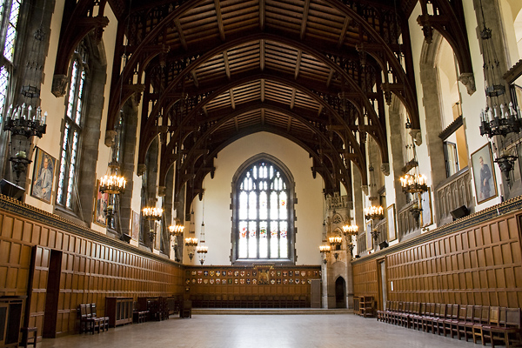
The Great Hall
This is where some of our plenaries and our party will take place

Slide 5
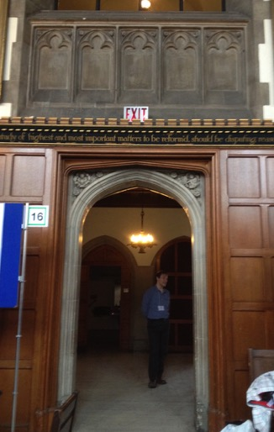
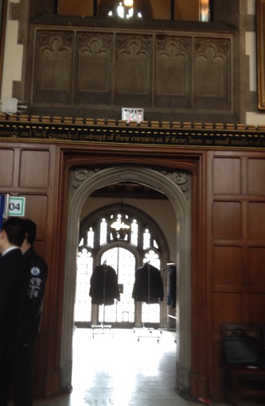
Two large entrance ways lead out of the Great Hall …

Slide 6
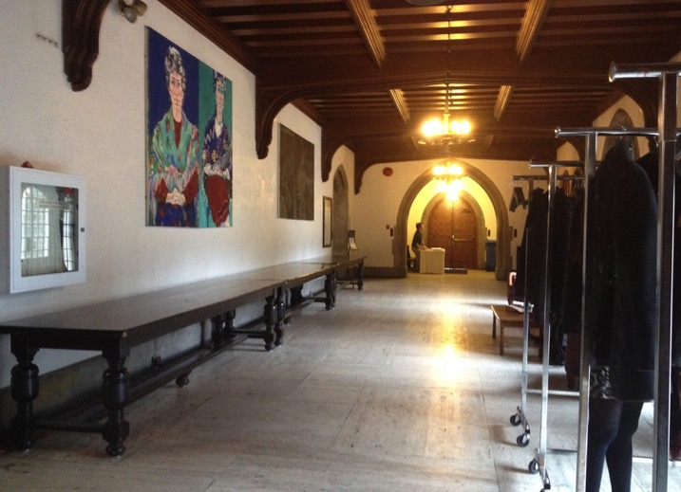
Leading to the Lower Gallery

Slide 7
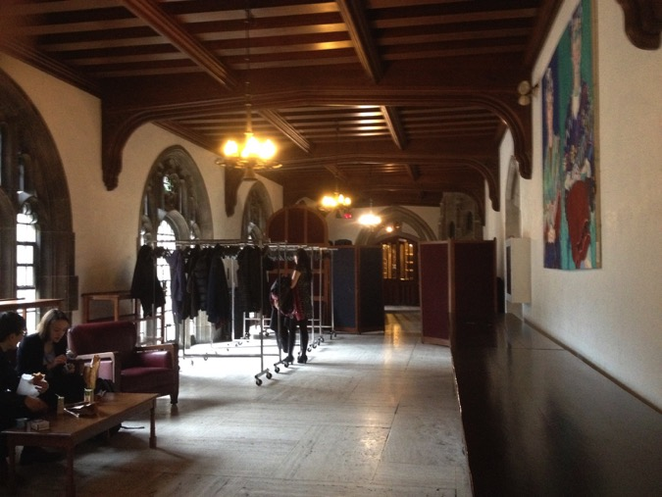
The Lower Gallery
Location of coffee breaks and Publishers Display

Slide 8
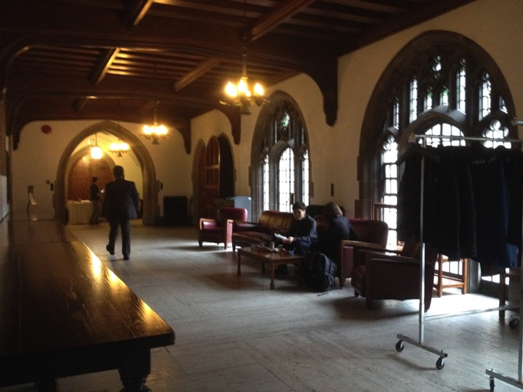
The Lower Gallery
Location of coffee breaks and Publishers Display

Slide 9
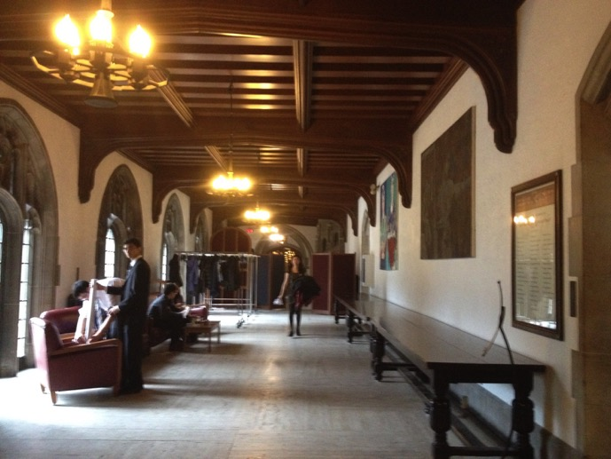
The Lower Gallery
Location of coffee breaks and Publishers Display

Slide 10
Stage/Dias
piano
30’ Drape
7’ clearance
from wall
Screens must sit in front of chandeliers
Great Hall
Founders Prayer Hallway
Patio
(Fire Exit Clearway)
Lower Gallery
WC
Directory
Location of Coffee breaks and Publisher’s Display
Floor plan of Great Hall and Lower Gallery

Slide 11
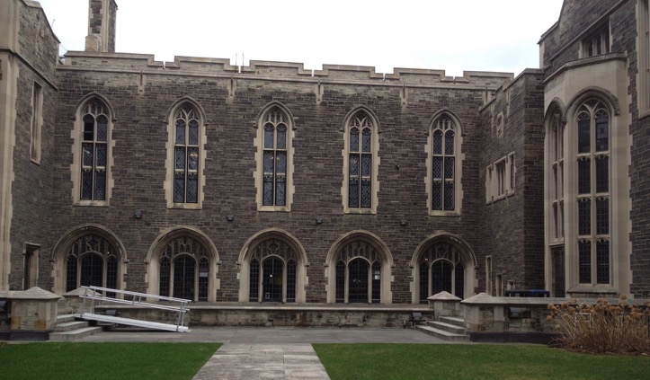
The Lower Gallery opens to courtyard
Delegates can wander or sit with their beverages and talk

Slide 12
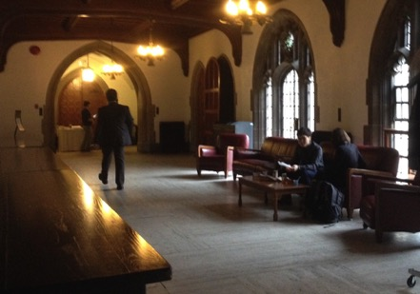
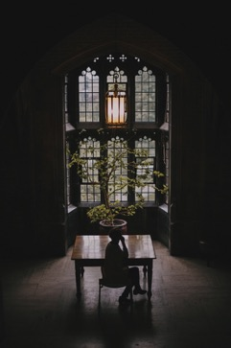
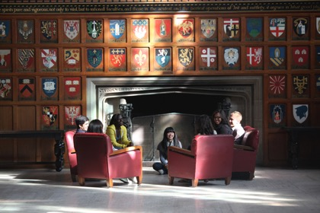
Hart House has many places to talk; corners to chat

Slide 13
Please consider being one of the publishers at the NWAV 44 Publisher’s Display

